Slide 1

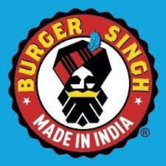
a study on food brand (burger Singh)
PRESENTATION BY:-
Aradhna Barve
Ananya Singh
Sujal Ahirwar
Tanmay Dhakad

Slide 2
Introduction
Burger Singh is a fast food chain that has disrupted the Indian fast food market with its unique menu offerings that fuse classic American fast food with Indian flavors. Founded in 2014, the company has quickly grown to become a favorite among young Indian consumers, with over 35 outlets across India, as well as locations in the United Kingdom and the United States. This case study analyzes how Burger Singh has been able to differentiate itself in a crowded market, leveraging innovative marketing and branding strategies, as well as menu innovation and a unique customer experience

Slide 3
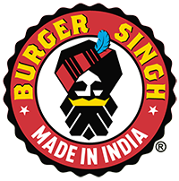
About burger Singh
Burger Singh is Gurgaon based fast food chain which operates under the company name tipping Mr. Pink Pvt ltd.
Burger Singh was founded in November 2014 by three childhood friends Kabirjeet Singh ,Rahul Seth and Nitin Rana
Kabir Jeet Singh – Founder
Nitish Rana – Co -Founder
Burger Singh has followed a unique market strategy that has helped it stand out from other fast food chains in the Indian market. Here are some of the key elements of the company's market strategy:
Unique Menu
Social Media Marketing
Customer Engagement
Lean Cost Structure

Slide 4
Literature REVIEW
Academic year: 2020/2021 University-SRM Institute of Science and Technology by-SANJAY MEHROTRA
This Article shows how Burger Singh plans to be the king in QSR(Quick Service Resturant )
Burger Singh’s marketing plan includes all the required aspects of the company ,which are used in approaching a maximum customer base and increasing its market share.
Burger Singh’s SWOT ananlysis identifies its company strengths ,weaknesses, oppourtunities and threats in three stakeholders group. These factors can be used to maximize company potential for accomplishes goals in the fast food industry.

Slide 5
JULY 21 2022
By Ajinkya Salni
Burger Singh has raised 30 crore in series. A funding round led by Negen Capital the fresh capital will be used to expand the franchise with additional 120 food outlets , accelerates brand growth and hiring.
The company is the fastest growing burger chain of India origin . It also has the country’s 3rd highest burger delivery volumes.
5 OCTOBER 2015
By Priyanka Sahay
According to this report, Burger Singh is working with Tipping Mr. Pink Pvt ltd to expand its business.
Gurgaon based Tipping Mr. Pink Pvt ltd ;Which runs QSR chain and online ordering site Burger Singh ,has raised $500,000 in fresh funds from a group of Investors.

Slide 6
Objective
1)To know how BURGER SINGH gained its reach.
2) Knowing about consumer reaction to the new food chain.
3) To know about the marketing mix and pricing.
4) Knowledge about the advertising strategy.
5) Knowledge about the competition.

Slide 7


RESEARCH METHODOLOGY, DATA TOOLS AND limitations
Limitation
Limited access to data.
Lack of previous research study
The data we grabbed from the previous research paper was not updated as per research scenario.
Sample size depends on the nature of the research problem.
Research methodology
Data collection methods:-
sources
Primary Secondary
GOOGLE FORMS ONLINE . . LITERATURE REVIEW
{QUESTIONNARIES)

Slide 8
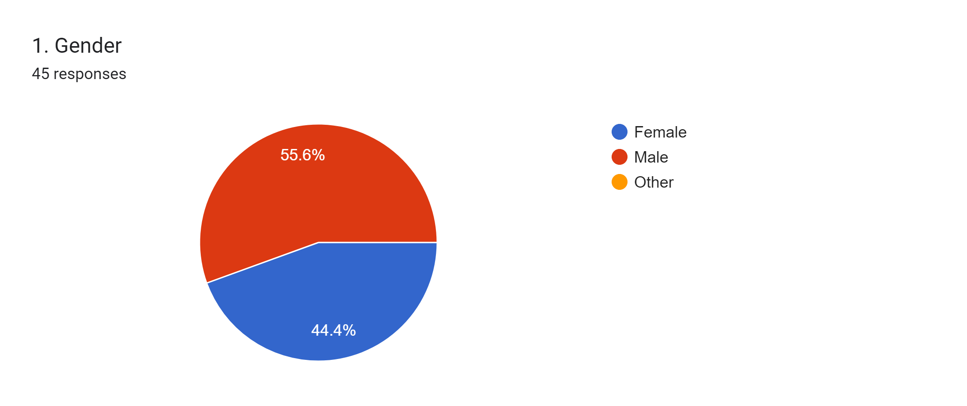
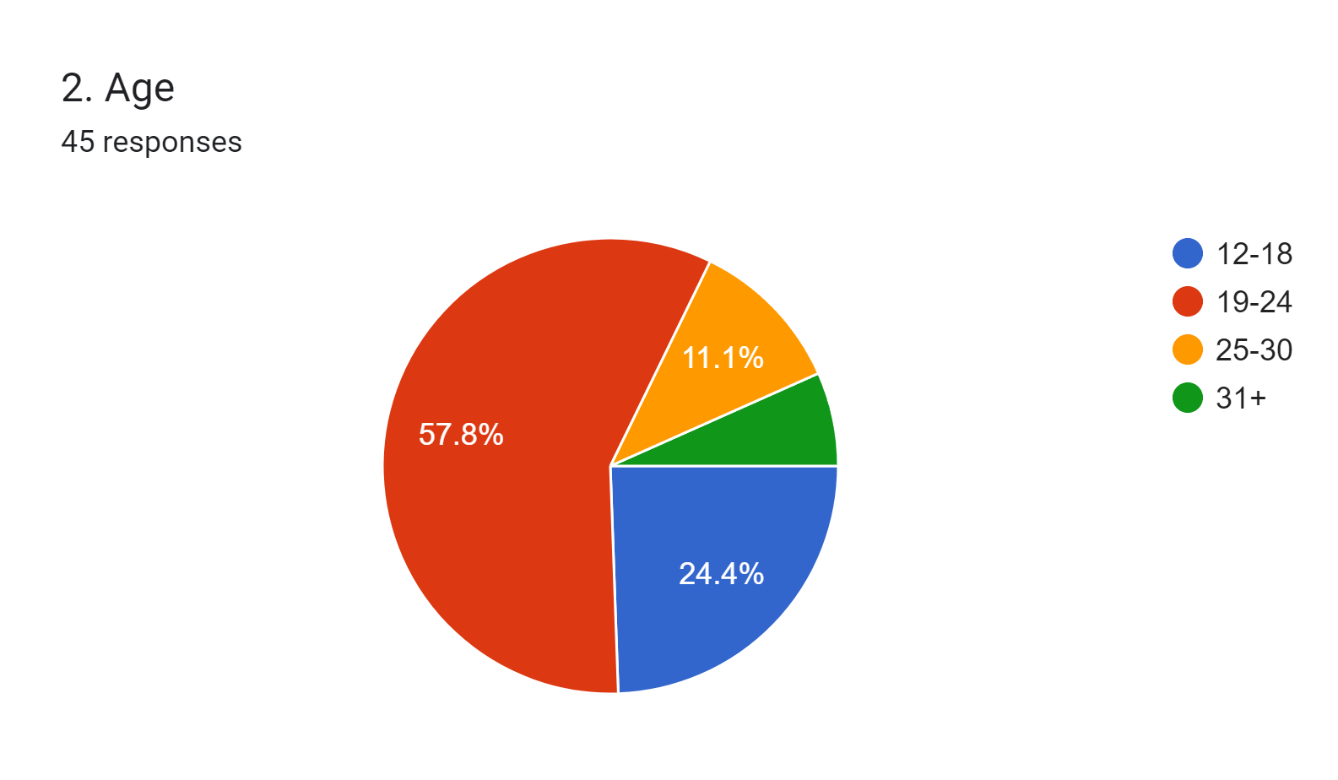

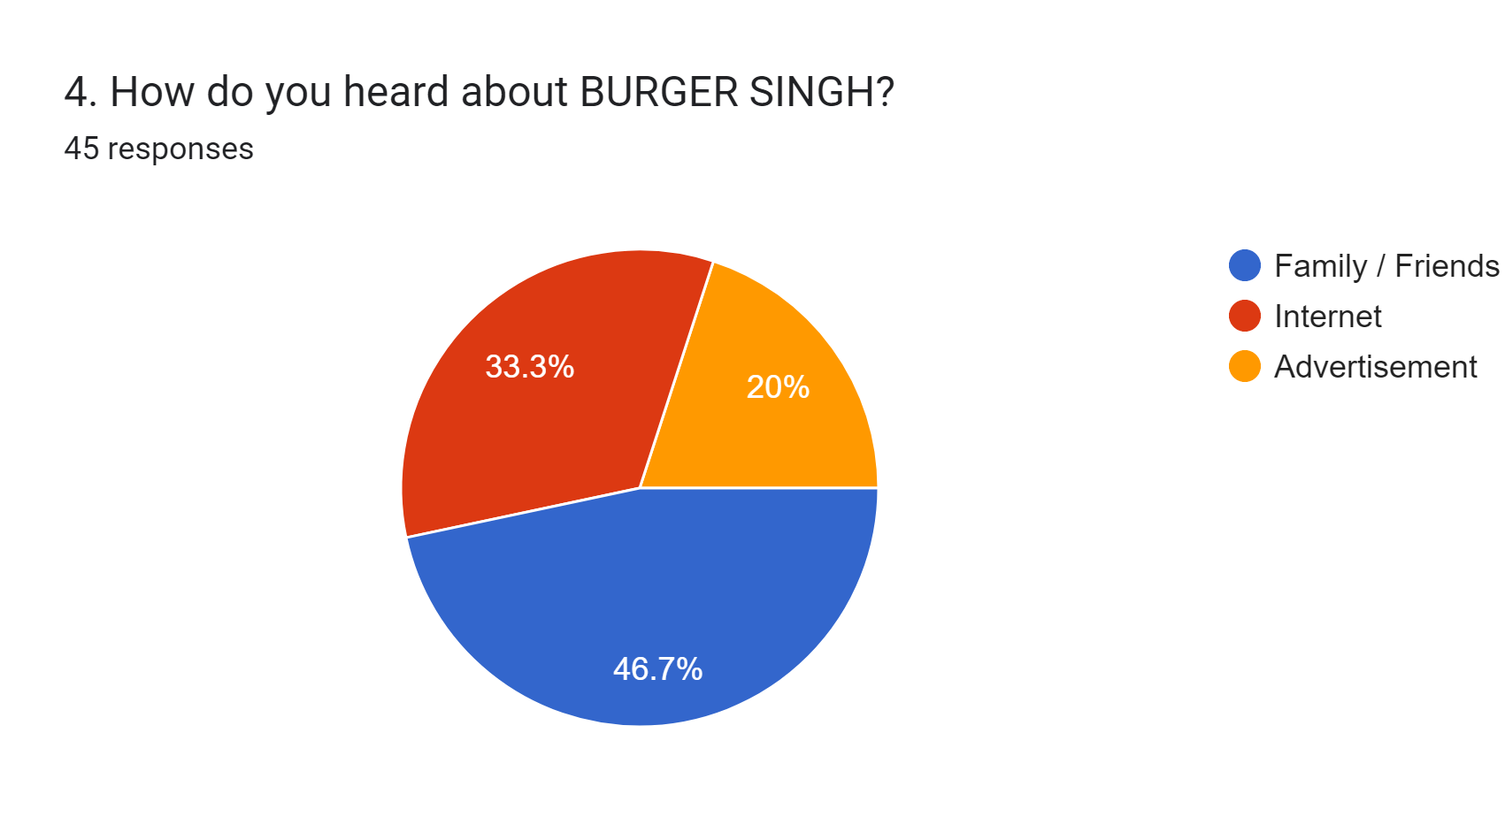
Questionnaire

Slide 9
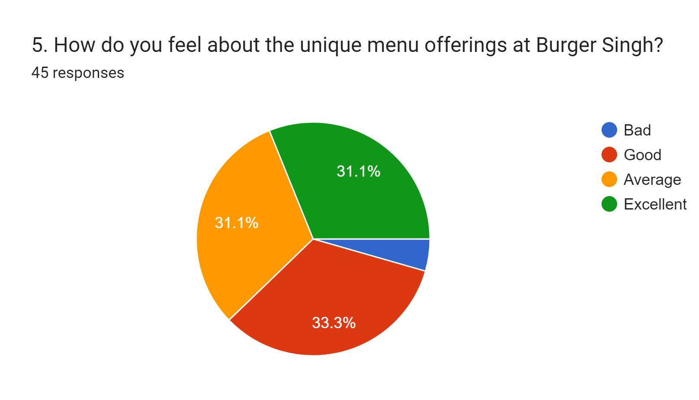

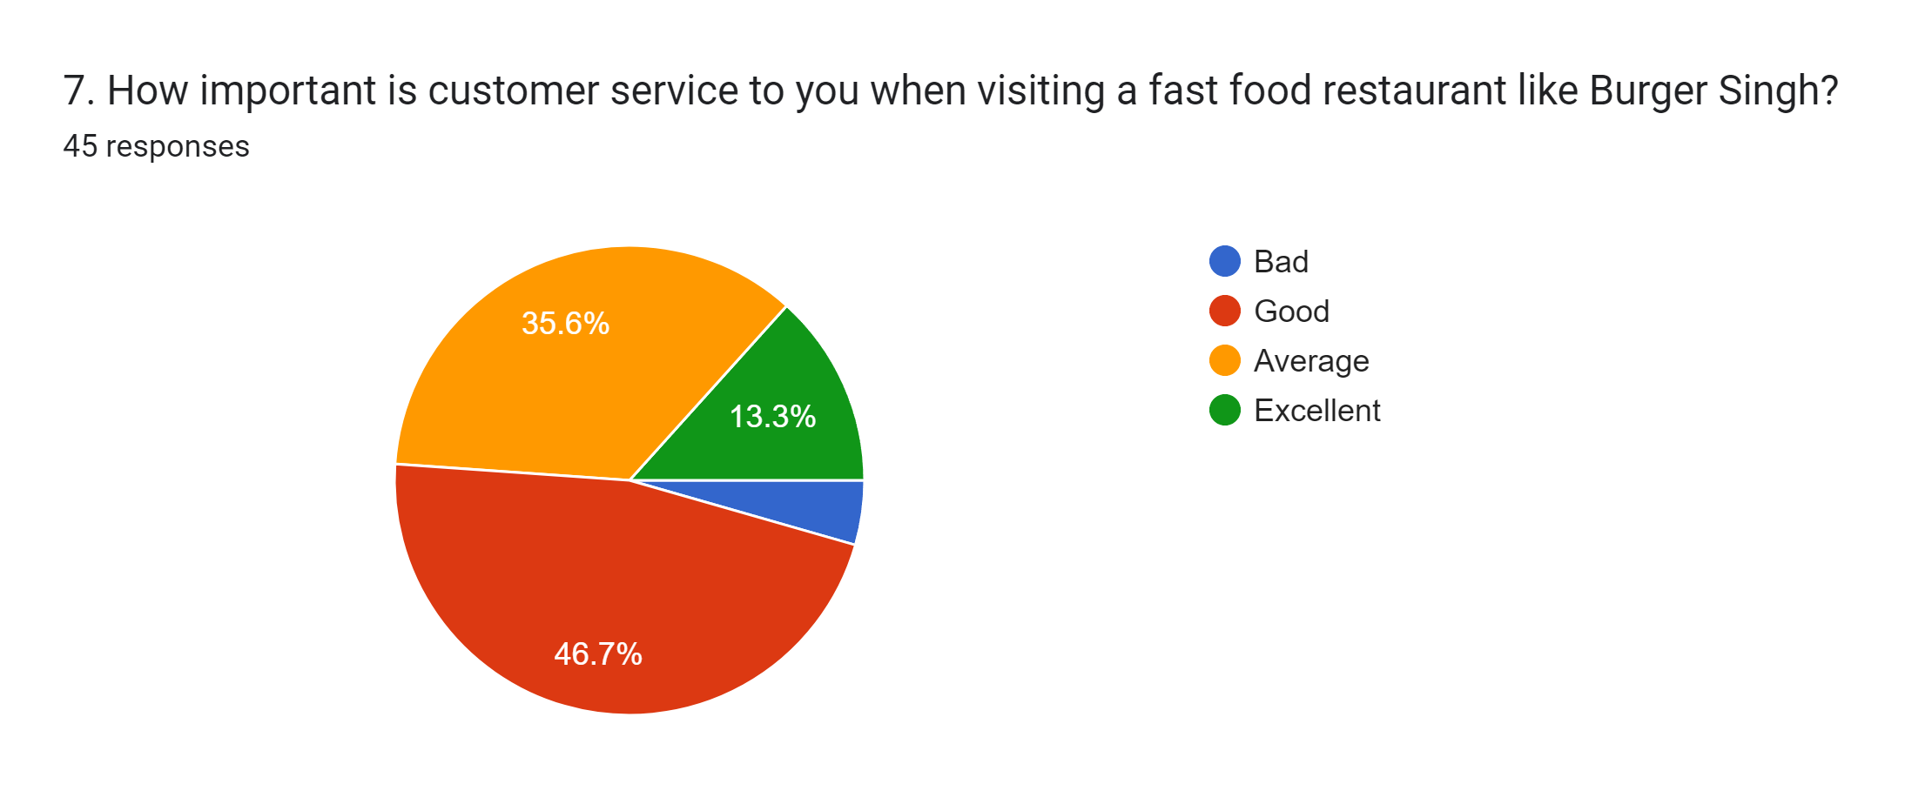
Questionnaire

Slide 10
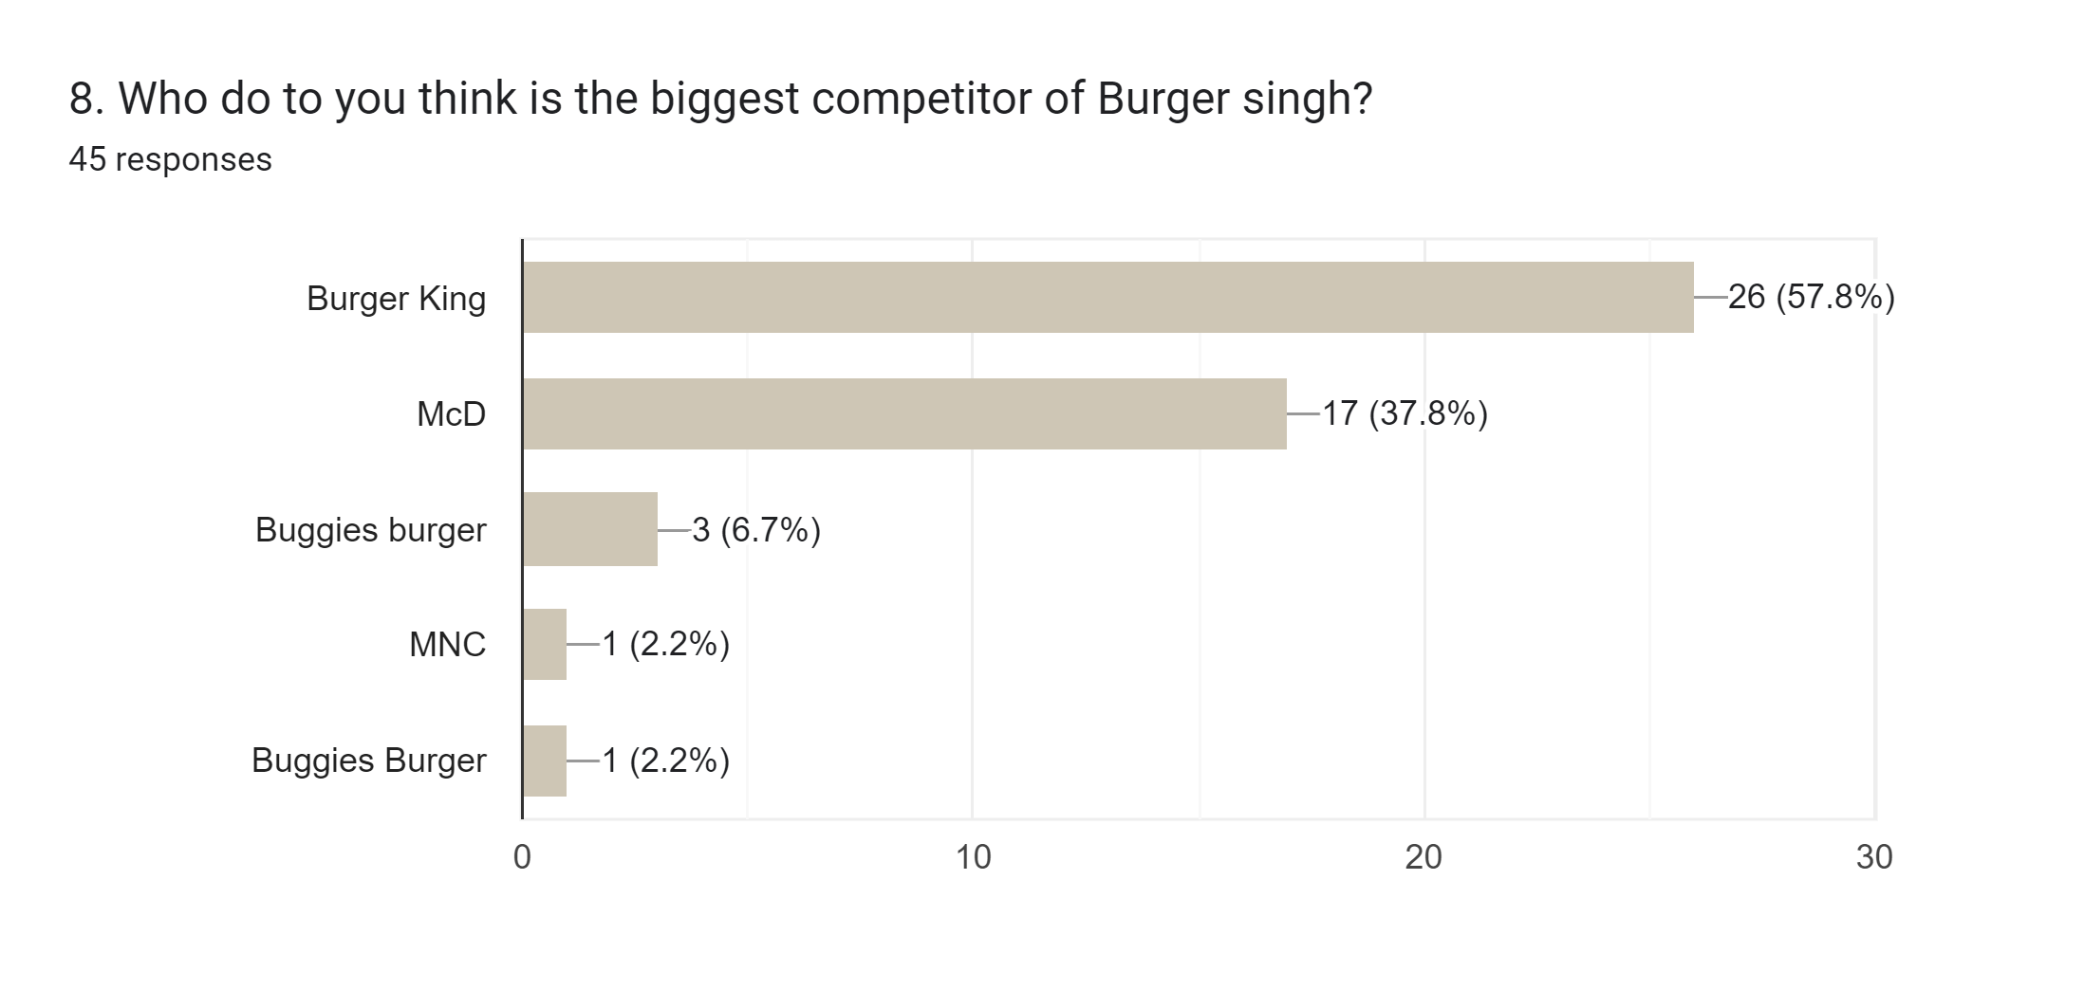
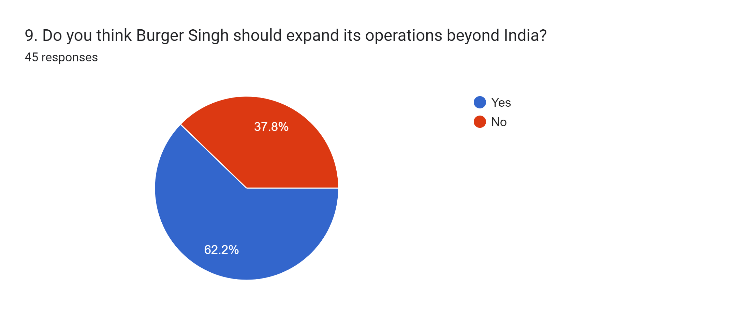
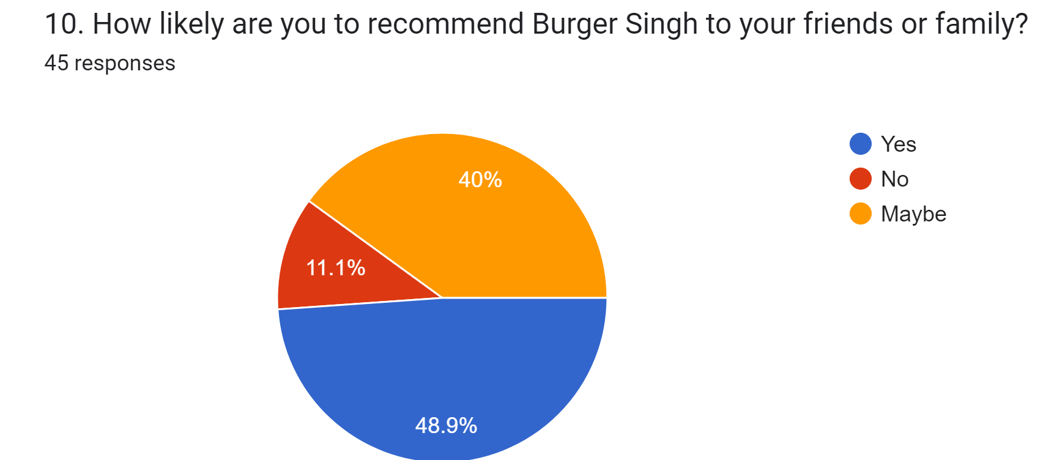
Questionnaire

Slide 11
Conclusion
Through our survey on BURGER SINGH, the researchers have found out that most of the consumers are adults who are aged between 19 - 24, Burger Singh has gained its reach by spreading its awareness to people through family and friends. Tho they try to provide unique items in their menu but some people find it average/regular. The main thing which attracts people is their price, it's very affordable for most of the people. Their biggest competition is Burger King.

Slide 12
Thank you

